Slide 1
AIML- Premalatha T

Slide 2
WHO AM I?
LinkedIn: https://www.linkedin.com/in/latha-t-k-b21018128/
Data Science ,AIML
Data Analysis ,SQL,Pyspark
Data Visualization ,PowerBI,Tableau
Natural Language Processing (NLP)
Computer Vision
Generative AI,Prompt Engineering
BigData and Data Engineering

Slide 3
Agenda
Types of Analytics
Steps in a ML Project
Supervised and Unsupervised Learning
Regression and Classification

Slide 4
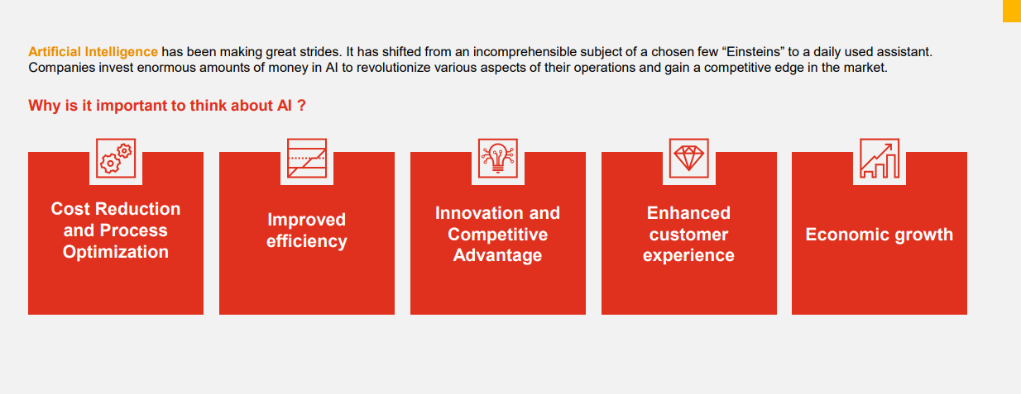

Slide 5


Slide 6
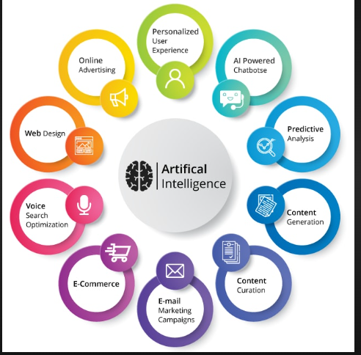

Slide 7
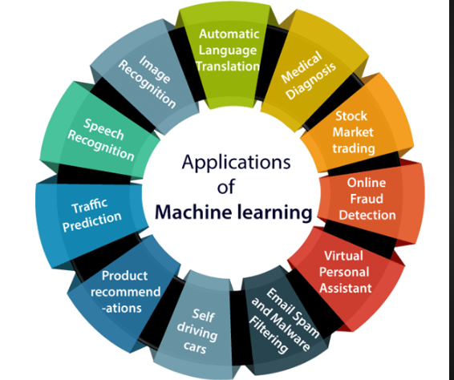

Slide 8
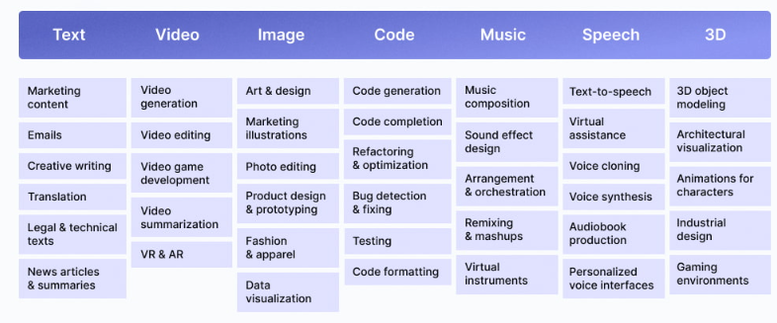

Slide 9
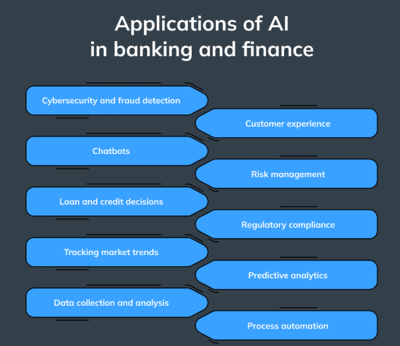

Slide 10
Data?
Information + Noise
Information(useful)
75% ->Try to get 100%
Possible? NO

Slide 11
Types of Analytics
In today's data-driven world, information is king. But raw data itself isn't enough.
We need to analyze it to extract insights and make informed decisions

Slide 12
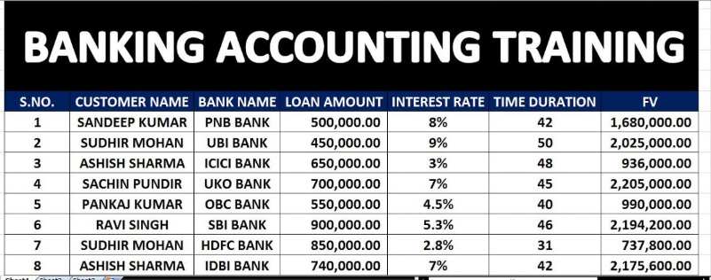
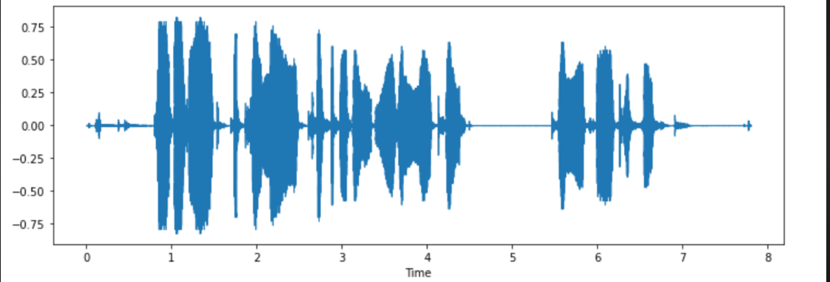
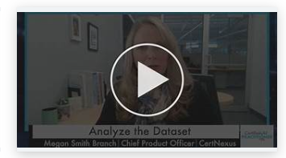

Slide 13

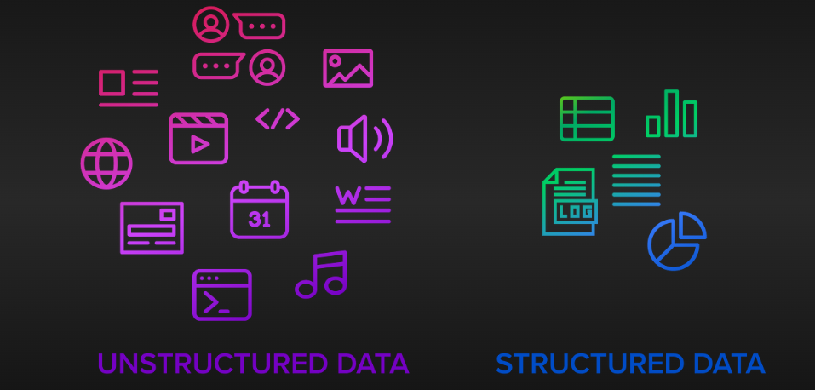

Slide 14
Check!!!
Is the data organized into rows and columns?
Does the data follow a consistent format throughout?
Can the data be easily queried using a structured query language (SQL) or similar?
Does the data lack a predefined structure or format?
Is the data primarily composed of free-form text or multimedia content?
Is the organization of the data irregular or unpredictable?

Slide 15






Slide 16
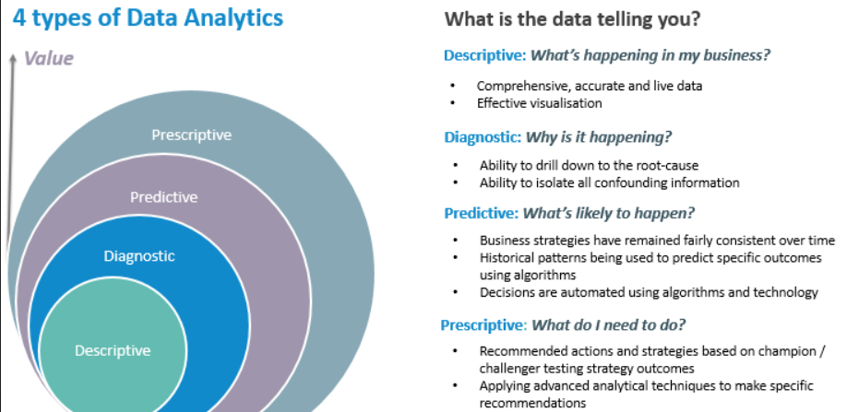

Slide 17
Case Study: How JP Morgan Uses AI to Combat Financial Fraud

Slide 18
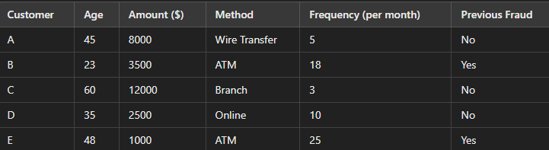

Slide 19
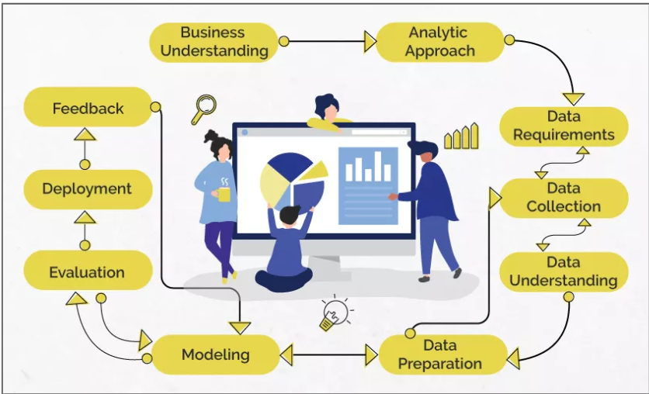
Data Science/Machine Learning

Slide 20
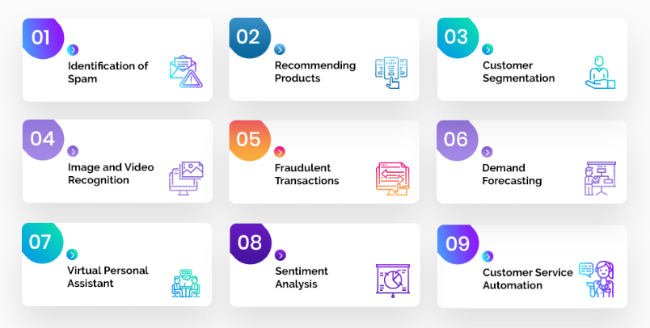
Problem Statement

Slide 21
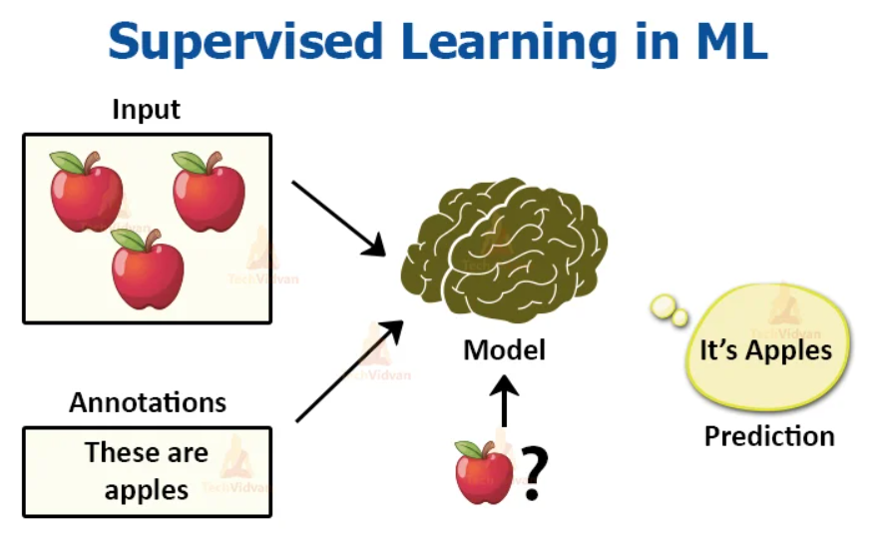
Analytic Approach

Slide 22
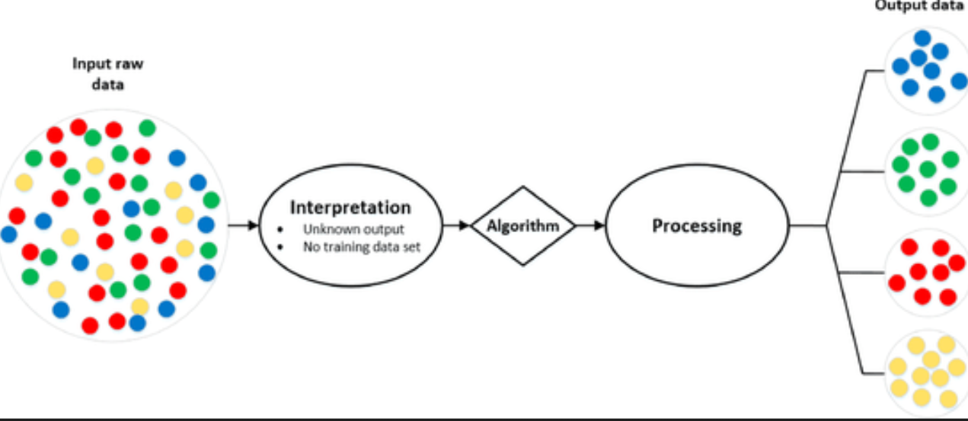
Analytic Approach

Slide 23
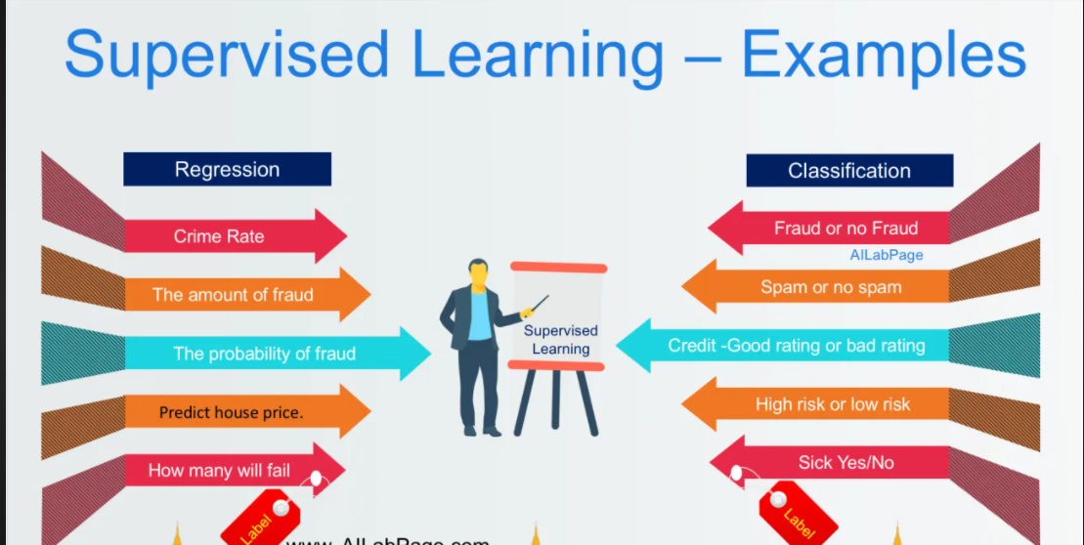
Supervised Learning

Slide 24
Machine Learning
Supervised Learning
Unsupervised Learning

Slide 25
Data understanding
Qualitative
Quantitative
Discrete
Continuous
Categorical
Ordinal

Slide 26
Data preparation
Missing Values
Outliers
Handling Categorical variables
Redundancy in data

Slide 27
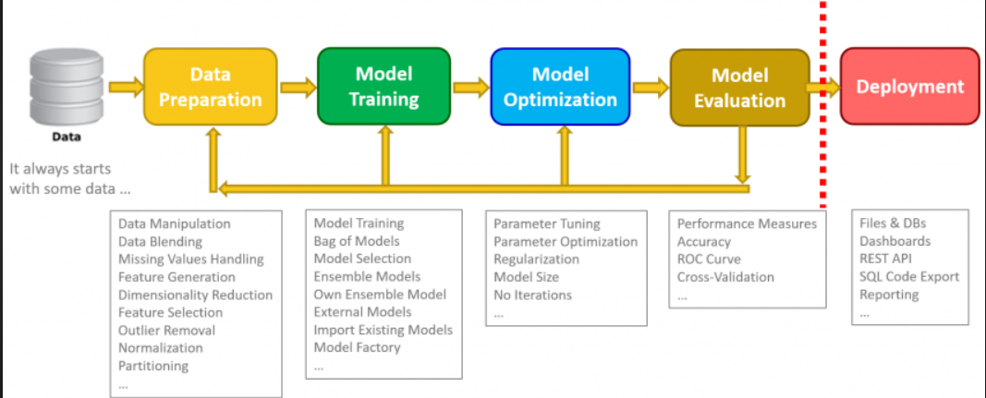
Data Science

Slide 28
Questions ????

